Slide 1

Microsoft Power BI

Slide 2
What is Business Intelligence
Is a set of processes, architectures, and technologies that convert raw data into meaningful information that drives profitable business actions.
It is a suite of software and services to transform data into actionable intelligence and knowledge.

Slide 3
Business Intelligence
BI has a direct impact on organization’s strategic, tactical and operational business decisions. BI supports fact-based decision making using historical data rather than assumptions and gut

Slide 4
Business Intelligence
It’s increasingly important for businesses to have a clear view of all their data to stay competitive, which is where business intelligence (BI) tools come in.
Businesses and organizations have questions and goals. To answer these questions and track performance against these goals, they gather the necessary data, analyze it, and determine which actions to take to reach their goals.
On the technical side, raw data is collected from business systems. Data is processed and then stored in data warehouses, the cloud, applications, and files. Once it’s stored, users can access the data, starting the analysis process to answer business questions.
BI platforms also offer data visualization tools, which convert data into charts or graphs, as well as presenting to any key stakeholders or decision-makers.

Slide 5
What is the role of business intelligence?
Business intelligence greatly enhances how a company approaches its decision-making by using data to answer questions of the company's past and present.
It can be used by teams across an organization to track key metrics and organize on goals.

Slide 6
What are the benefits of using business intelligence?
Benefits of business intelligence:
Enhance Business Productivity. In the race to reach and stay at the top, organizational productivity is often overlooked in business. ...
Improve Access to Crucial Information. ...
Boost ROI. ...
Fuel Strategic Decision-Making. ...
Eliminate Waste. ...
Identify Opportunities.

Slide 7
What is an example of business intelligence?
Sales, marketing, finance and operations departments use business intelligence.
Tasks include quantitative analysis, measuring performance against business goals, gleaning customer insights and sharing data to identify new opportunities

Slide 8
Basic Components Within Business Intelligence:
The data itself (raw data)
The data warehouse.
Data access, analytics, and presentation.
Data dashboarding and reporting.

Slide 9
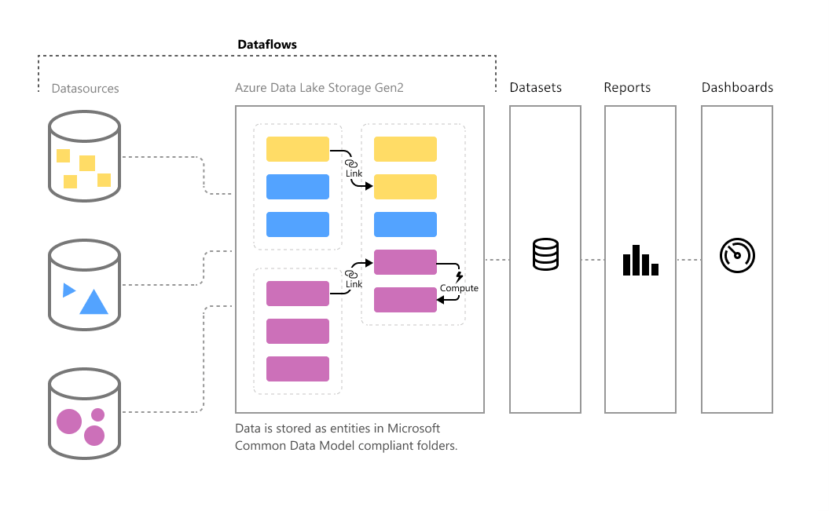
Data Flow and Data Source

Slide 10
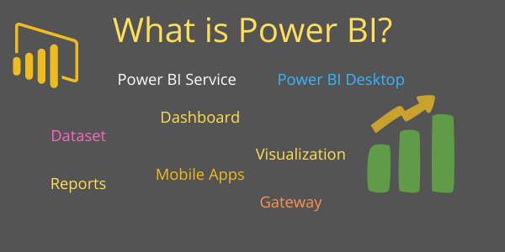
What is Power BI
Power BI is a very powerful Data Visualization and Business Analytics tool provided by Microsoft.
It help us to provide interactive visualizations, dashboard & Bi Reports with self-service capabilities.
Using this tool we can connect with different data sources like Excel, Text/ CSV, SQL and many more.

Slide 11
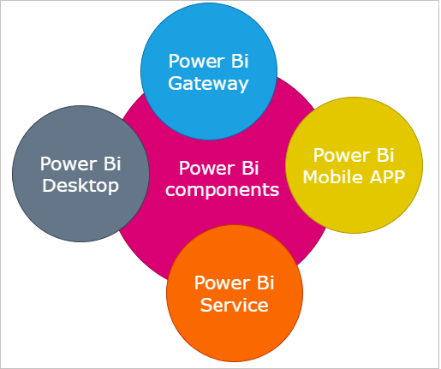
Components of Power BI
Power BI Desktop: It is free desktop application you can install this in your local computer & it is used to create reports and data visualizations on the data set.
Gateway: It is used to create connection between Power BI cloud Reports Data set and the data source located on-premises.
Power BI Service: Power BI allows you to publish Power BI Desktop reports and data visualizations into Power Bi cloud.
Mobile Apps: Using Power BI mobile apps, you can stay connected to their data from anywhere. Power BI apps are available for Windows, iOS, and Android platform.

Slide 12
What is Power BI
Power BI is a collection of software services, apps, and connectors that work together to turn your unrelated sources of data into coherent, visually immersive, and interactive insights.
Your data may be an Excel spreadsheet, or a collection of cloud-based and on-premises hybrid data warehouses.
Power BI lets you easily connect to your data sources, visualize and discover what's important, and share that with anyone or everyone you want.

Slide 13
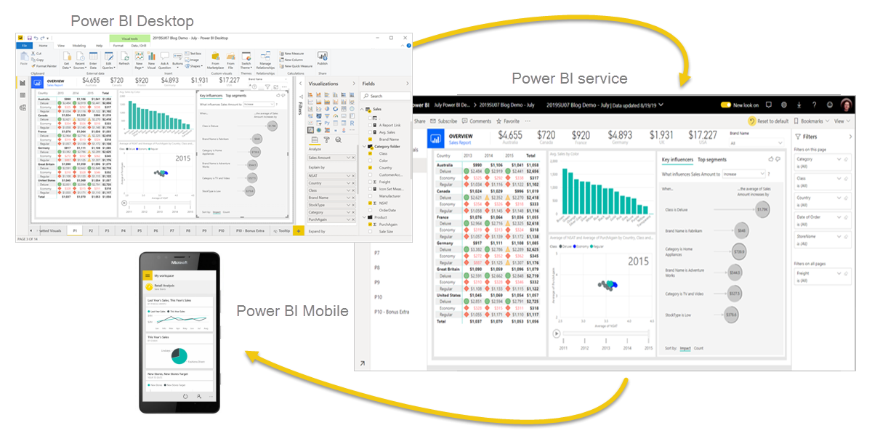
The parts of Power BI
A Windows desktop application called Power BI Desktop.
An online SaaS (Software as a Service) service called the Power BI service.
Power BI mobile apps for Windows, iOS, and Android devices.

Slide 14

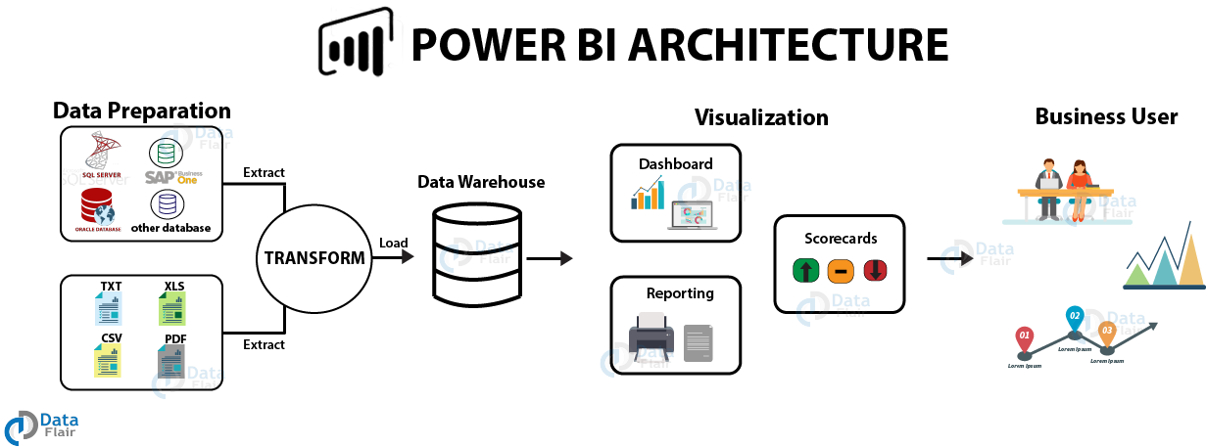
Power BI Architecture

Slide 15
Why Power BI
Real-time analysis in Power BI can be done by establishing direct connections to the data sources. Also, it keeps data updated to the latest second by data refreshing.
You can use custom visualizations from a custom visuals gallery. Custom visuals are divided into many options and categories.
You can quickly search for important insights and datasets within your data by using the Quick Insights option.
Establish a live or non-live connection to on-premises data sources like SQL Server, and use a secure channel to access data through data gateways. This makes Power BI enterprise-ready as on-premises connections make data transfer secure and the technology scalable and reliable.
You can connect to other services through Power BI such as SQL Server Analysis Services (SSAS), Microsoft Excel, etc.
Power BI is a new age software using the latest technologies such as HTML 5.0, column store databases, cloud computing, mobile apps, etc. This helps in keeping Power BI on the top and popular as it is constantly getting updated with the latest features.

Slide 16
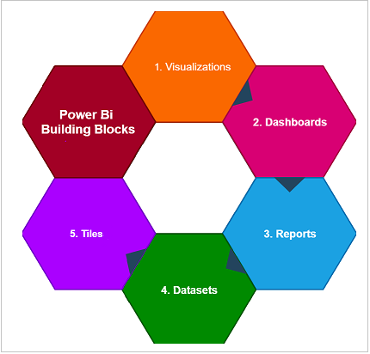
Building blocks of Power BI
Here are the basic building blocks in Power BI:
Visualizations
Dashboards
Reports
Datasets
Tiles

Slide 17
Building blocks of Power BI
Visualization: It is a visual representation of data to using Dataset in Power BI Report, like line chart, bar chart, column chart, map, Matrix etc.
Datasets: It is a collection of data that Power BI uses to create its visualizations.
Reports: Report is a collection of visualizations that appear together on one or more pages.
Dashboards: It is single screen presentation of multiple visualizations.
Tiles: It is a single visualization in a report or on a dashboard, like Pie chart in Dashboard or Report.

Slide 18
Installation
Install Power Bi software
Powerbi.microsoft.com
Powerbi Desktop Free version
Rest all are paid version
Use below link to download Power Bi Desktop latest version
https://powerbi.microsoft.com/en-us/downloads/

Slide 19
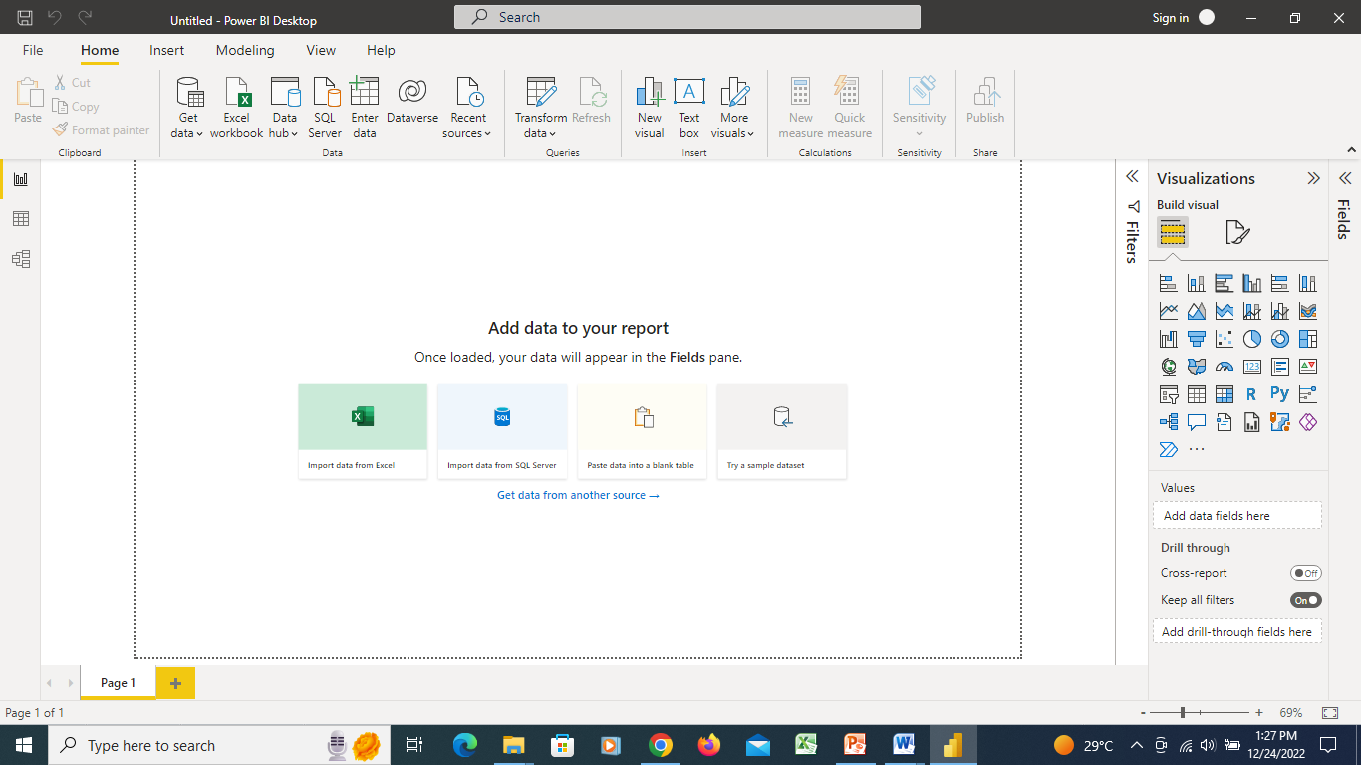
Power Bi Screen

Slide 20
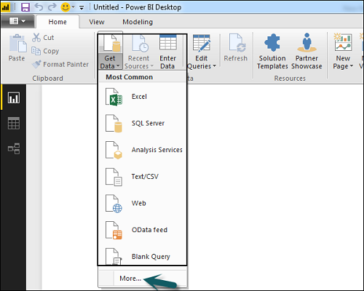
Get DataSource in Power BI

Slide 21
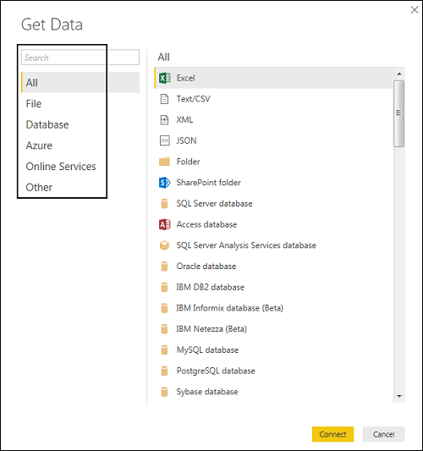

Slide 22
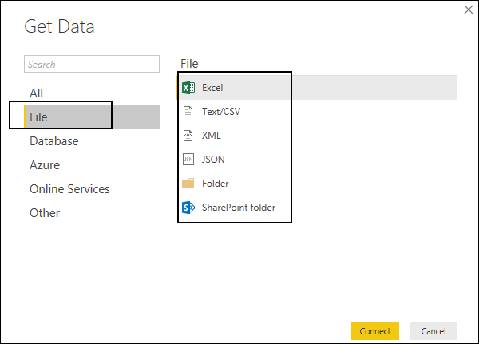

Slide 23
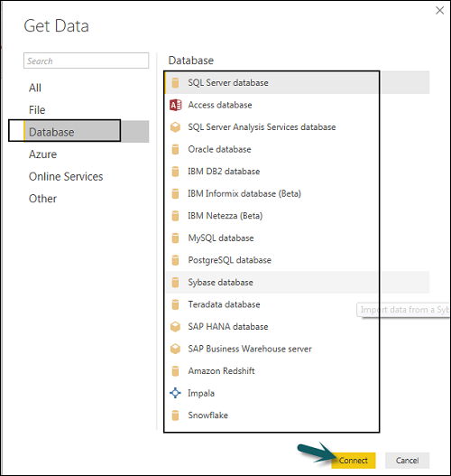

Slide 24
DataSource – Excel File
Excel file which has data for Visualization.
Click Get Data to connect to data from multiple data sources.
In this mode Power BI Desktop store the data inside Power BI Cache.
If your data size is less then 1 GB or data not continually changing then you can use Import mode.

Slide 25
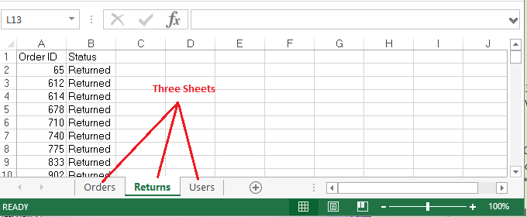
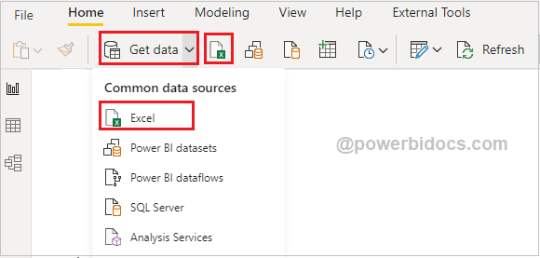

Slide 26
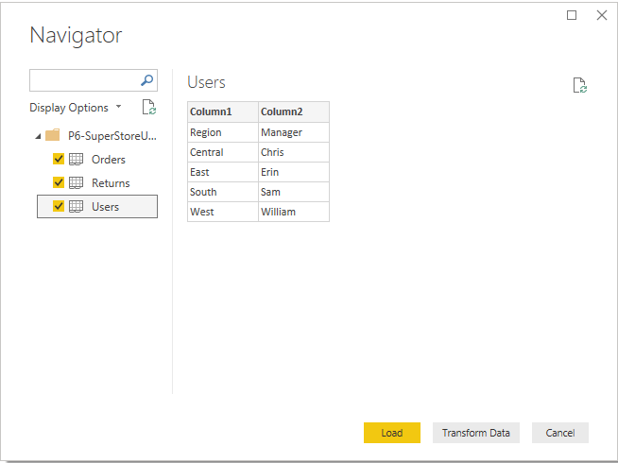
DataSource – Excel File

Slide 27
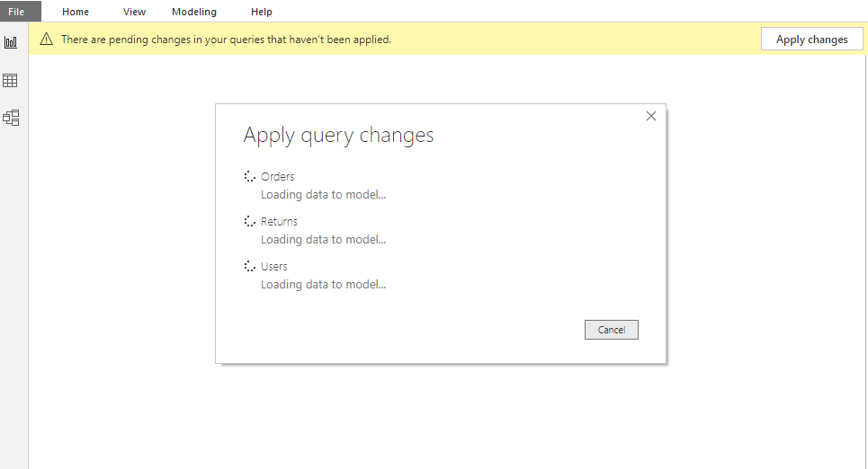
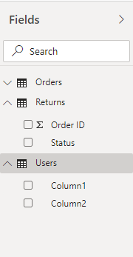
DataSource – Excel File

Slide 28
Import SQL Data - RDBMS
Power BI Desktop support two types of data source connection mode like Import & Direct Query mode. Here we will talk about Import mode.
In import mode Power BI Desktop store the data inside Power BI Cache. If your data size is less then 1 GB or data not continually changing then you can use Import mode.
Import mode is very fast compare to Direct Query mode because all data comes from Power Bi Desktop Cache, so you can use this mode to develop & testing purpose.

Slide 29
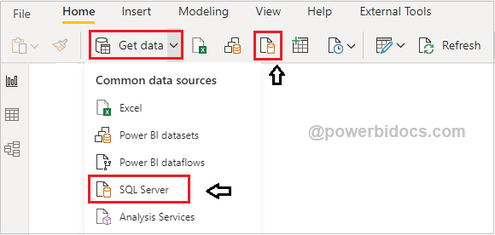
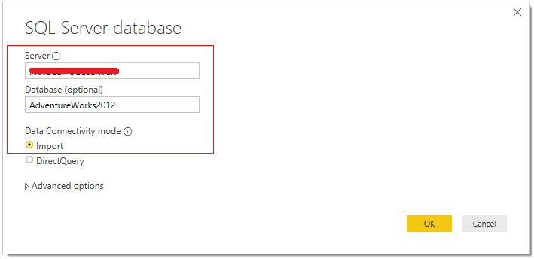
Import SQL Data - RDBMS
sS

Slide 30
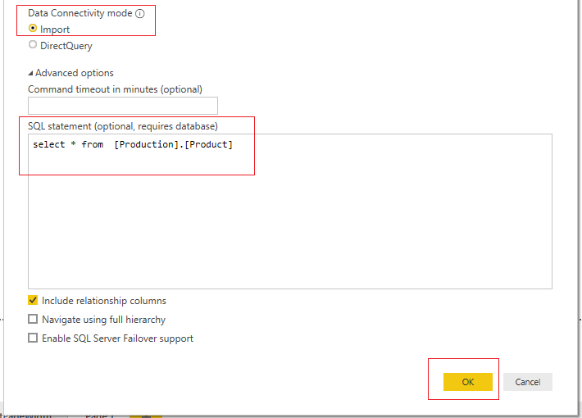
Import SQL Data - RDBMS

Slide 31
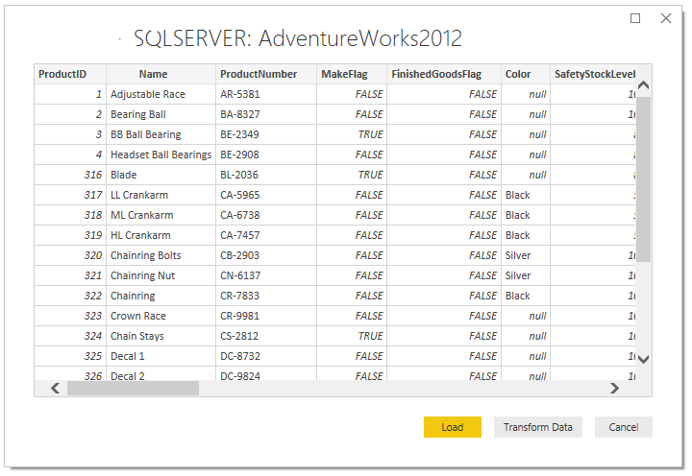
Import SQL Data - RDBMS

Slide 32
Difference Mode
Feature | Import | DirectQuery
Size | Up to 1 GB per dataset | No limitation
Data Source support | Import data from Multiple sources | Data must come from a single Source
Performance | High-performance query engine | Depends on how fast the network connectivity and data source is as queries are executed in real-time. Only metadata and schema structure is stored on the Data model
Data Change in the underlying data | Not Reflected. Required to do a Manual refresh in Power BI Desktop and republish the report or Schedule Refresh | Power BI caches the data for better performance. So, it is necessary to Refresh to ensure the latest data
Data storage in Power BI | Since it is a cached mode, data is stored in the Power BI Service (cloud) | Data will not be stored in the Power BI cloud service. Data resides on-premises
Schedule Refresh | Maximum 8 schedules per day | Schedule often as every 15 mins

Slide 33
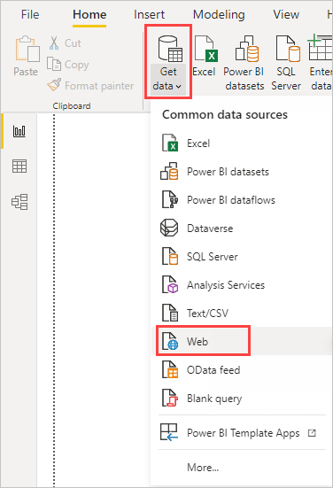
Connect to a web data source
Connect to a web data source and navigate across its available tables.
Shape and transform data in the Power Query Editor.
Name a query and import it into a Power BI Desktop report.
Create and customize a map and a pie chart visualization.

Slide 34
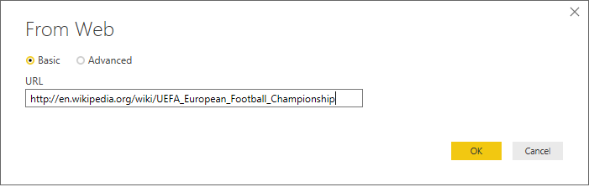
Connect to a web data source
In the From Web dialog, paste the URL
into the URL text box, and then select OK.
https://en.wikipedia.org/wiki/UEFA_European_Football_Championship.

Slide 35
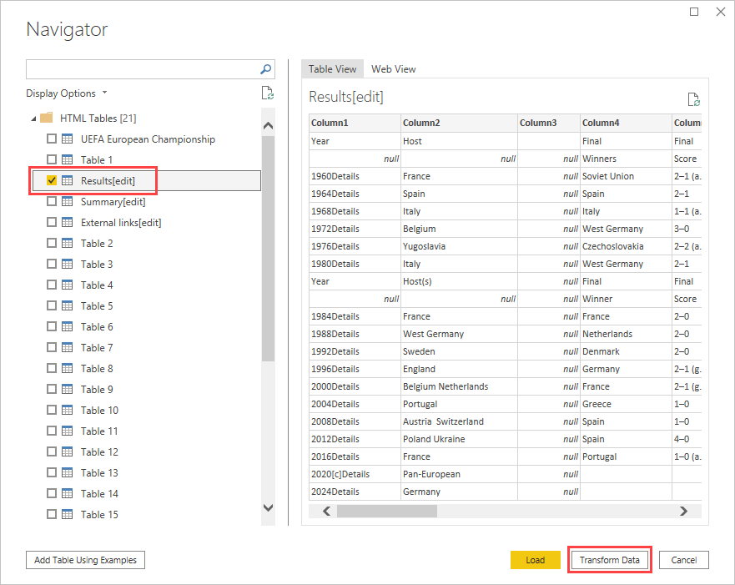

Slide 36
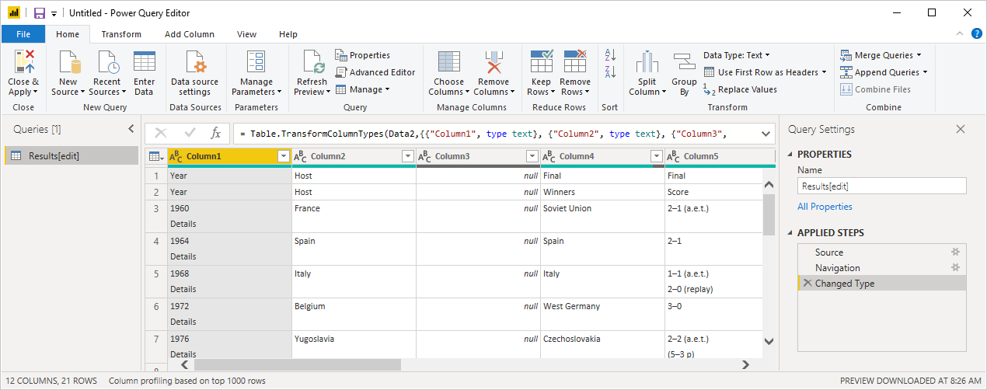
Connect to a web data source
Select the Results[edit] table in the Navigator list, and then select Transform Data.
A preview of the table opens in Power Query Editor, where you can apply transformations to clean up the data.

Slide 37
Shape data in Power Query Editor
You want to make the data easier to scan by displaying only the years and the countries/regions that won.
You can use the Power Query Editor to perform these data shaping and cleansing steps.
First, remove all the columns except for two from the table.
Rename these columns as Year and CountryRegion later in the process.

Slide 38
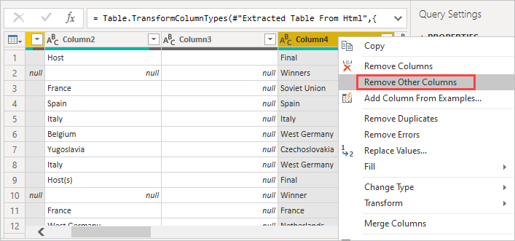
Power Query Editor

Slide 39
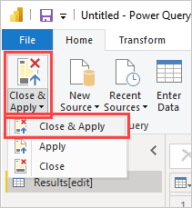
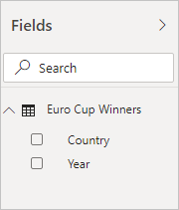
Power Query Editor
The query loads into the Power BI Desktop Report view, where you can see it in the Fields pane.

Slide 40
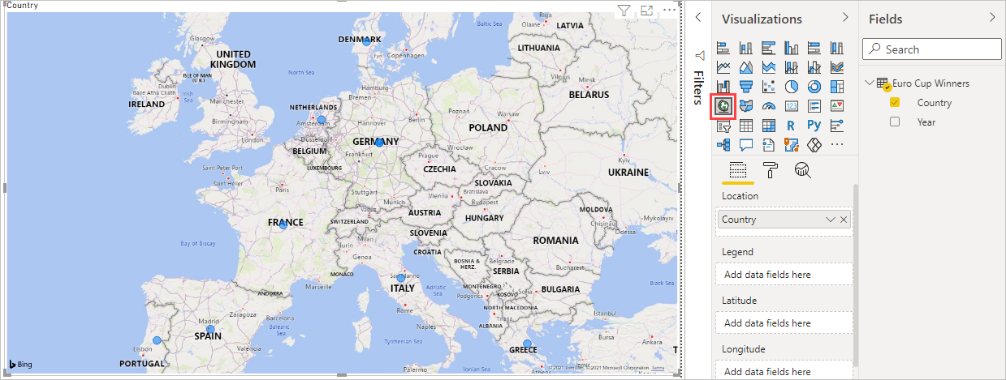
Create a Visualization
Select the CountryRegion field in the Fields pane, or drag it to the report canvas. Power BI Desktop recognizes the data as country/region names, and automatically creates a Map visualization.

Slide 41
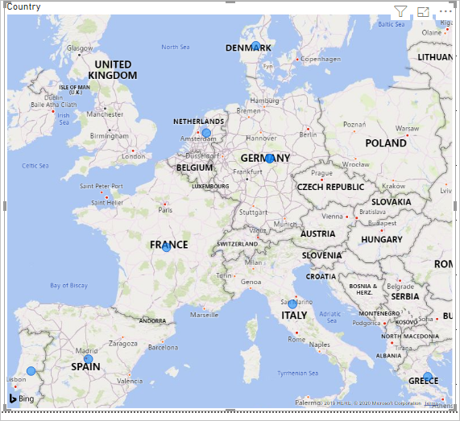
Create a Visualization
Enlarge the map by dragging the handles in the corners so all the winning country/region names are visible.

Slide 42
Power BI Native & Custom Visuals
Power BI Stacked Column Chart & Stacked Bar Chart both are most usable visuals in Power BI.
Stacked Column Chart is useful to compare multiple dimensions against a single measure. In a Stacked Column Chart, Axis is represented on X-axis and the data is represented on Y-axis.

Slide 43
Power BI Native & Custom Visuals
Clustered columns chart is useful to display comparison of multiple series as in vertical columns. Each data series shares the same axis labels, so vertical bars are grouped by category.
Clustered bar chart is useful to display comparison of multiple series as in horizontal columns. Each data series shares the same axis labels, so horizontal bars are grouped by category.

Slide 44
Power BI Native & Custom Visuals
Line charts is used to show change or trends over a period of time. A combination of two or more than two lines can be used to compare trends over time.
Card visualization is used to display single value like Total Sales, Counts & Single numbers in Report page & Dashboard.

Slide 45
Power BI Native & Custom Visuals
Power BI Matrix & Table :
Both are most frequently usable visuals used for presenting data in tabular format.
Table
In table we present data in 2-Dimension data grid format.
By default display all data, means flat data structure.
Rows not fixed but columns are fixed.
When you add new dimension you can add them as “Values” and it will appear as a new column in grid.
Matrix
It support Multidimensional data grid format.
Matrix automatically aggregate the data according to data behavior.
Rows & Columns both are not fixed.
Here you have option to add Values, Rows & columns.

Slide 46
Power BI Native & Custom Visuals
Multi-Row Card visual is used to display summary data or you can say data in group format.
Donut chart (Doughnut chart) is similar to a pie chart in that it shows the relationship of parts to a whole, where all pieces together represent 100%.
This charts are useful when you want to display small categories of data & avoid for many categories, or when categories do not sum to 100%.

Slide 47
Power BI Native & Custom Visuals
Scatter charts, also known as Bubble chart, shows the relationship between two numerical values.
Using two points of data we consider the chart a Scatter chart, when adding a third point of data then the chart will become a Bubble chart.
We usually use the third point for sizing, which turns the points into a circle with varying sizes based on the data in the size field.

Slide 48
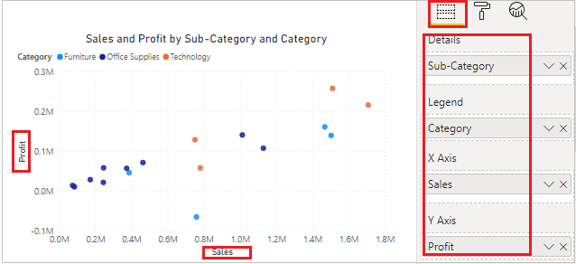
Power BI Native & Custom Visuals
1- Scatter Chart:
Comparing Sales & Profit values with Category & Sub category wise.
To plot the scatter chart need two values, so drag Sales & Profit as in X & Y-Axis.

Slide 49
Power BI Native & Custom Visuals
You can set the formatting for scatter chart, some important properties are:-
General: Allows you to set X axis, Y axis, width & height of chart.
Data colors: Using this section you can change the colors used for each series in the chart.
X-Axis: Allows you to modify the appearance of the x-axis section of this chart.
Y-Axis: Using this section allows you to modify the appearance of the y-axis section of this chart.
Category: Its enables the category name on scatter chart.
Fill Point: Fill the circle points by colors on chart, if you turned off this it will remove all category colors from circle points on chart.
Title: Specified the Title name for scatter chart.
Shapes: Using this you can change the marker shapes & size and you can customize the marker shapes for all category individually.
Zoom Slider: Enables zoom feature on chart, using this you can easily saw the small values on chart.

Slide 50
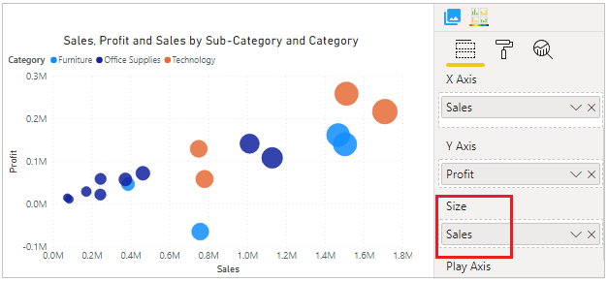
Power BI Native & Custom Visuals
2 – Bubble chart
A bubble chart replaces data points with bubbles, with the bubble size representing an additional third data dimension.
As you can see here in below screen shot we added third data point “Sales” under Size section, so it will increase the bubble size on the basis of sales volume under each category & subcategory.

Slide 51
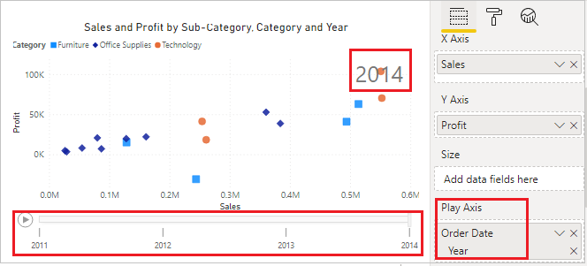
Power BI Native & Custom Visuals
3 – Data Storytelling with Power BI Scatter Chart
You can create a storytelling data with Scatter chart to using Play Axis feature of chart. Drag date column field here and click to play icon.

Slide 52
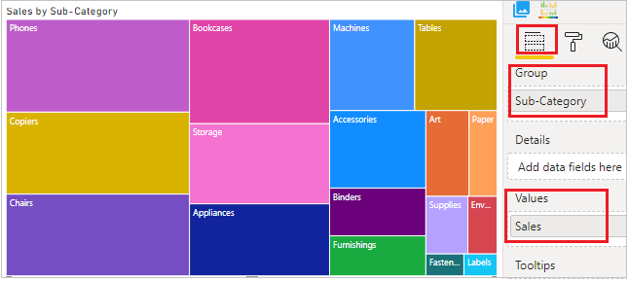
Power BI Native & Custom Visuals
Treemap is used to display large amounts of hierarchical data in Rectangle boxes.
Each level of the hierarchy is represented by a colored rectangle, known as “branch”.
If you add a category into the Details section of the visual, it will divide the branch into smaller “leaves”, hence the name Treemap.

Slide 53
Power BI Native & Custom Visuals
When to use a Treemap?
To display large amounts of hierarchical data.
When a bar chart can’t effectively handle the large number of values.
To show the proportions between each part and the whole.
Show the pattern of the distribution of the measure across each level of categories in the hierarchy.
To show attributes using size and color coding.

Slide 54
Power BI Native & Custom Visuals
Key Performance Indicator (KPI) visual
key performance indicator (KPI) is a very good way to track your current value movement against defined Target.
The intention of the KPI is to help you evaluate the current value and status of a metric against a defined target.
A KPI visual requires a base measure that evaluates to a value, a target measure or value, and a threshold or goal.
Use KPI Example Excel Dataset Sales2

Slide 55
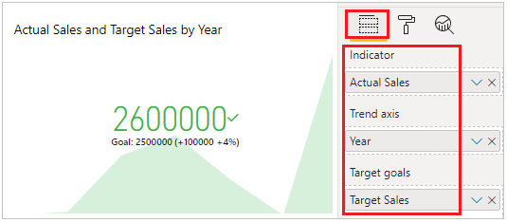
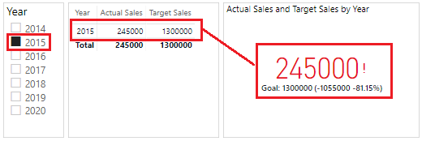
Power BI Native & Custom Visuals

Slide 56
Power BI Native & Custom Visuals
Create a KPI % measure?
Create a New measure
KPI % =
Var ActualSale= Sum(KPIData[Actual Sales])
Var TargetSale= Sum(KPIData[Target Sales])
Var diff = ActualSale - TargetSale
Return
DIVIDE(diff, TargetSale)*100
Use this measure for calculations …. A new column of KPI % is calculated in visuals.

Slide 57
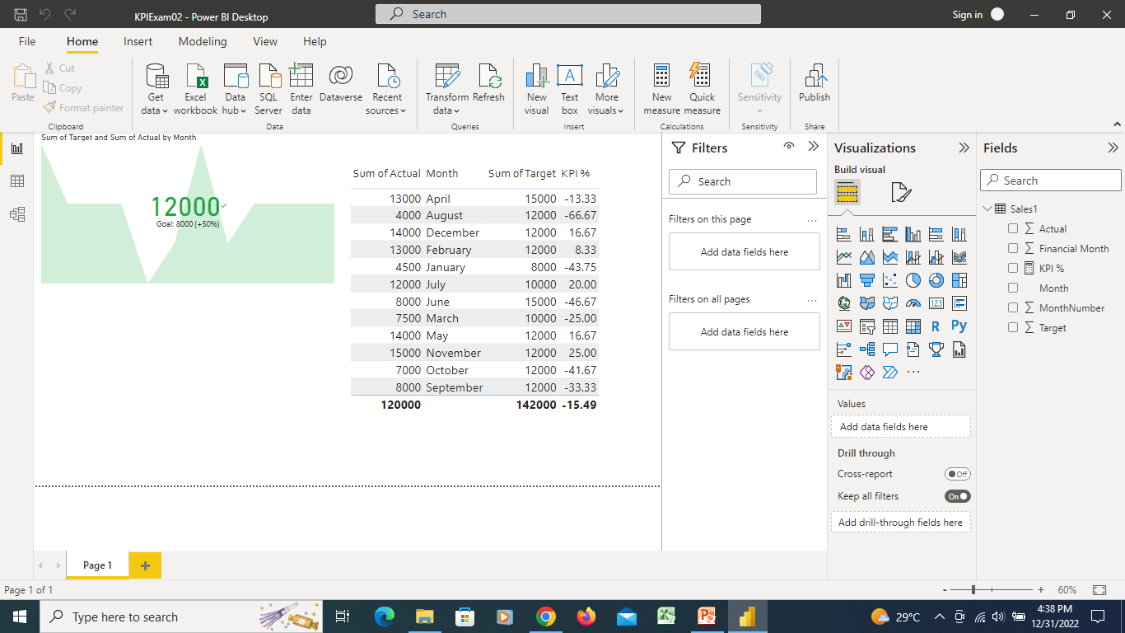
Power BI Native & Custom Visuals

Slide 58
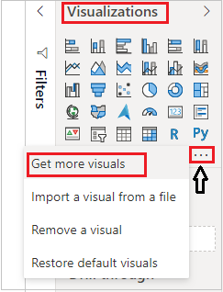
Small Multiple Line Chart Visual in Power BI
The Small Multiple Line Chart
(Custom visual) provides the ability to plot a line chart with small multiple line charts within a single visual that you can facet by an attribute value.

Slide 59
Small Multiple Line Chart Visual in Power BI
After that one pop-up window will be open, enter your power bi account mail id & password. If you already logged In into power bi desktop then this window will not come.
After logged In, you will see the Power BI visual pop-up window. Now follow these steps-
Under AppSource Tab > Select Category “All” > Search for “Small Multiple Line Chart” > Click on Add button

Slide 60
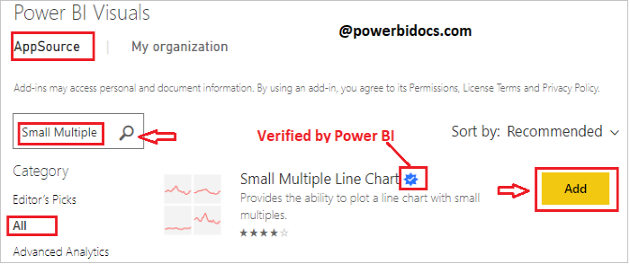
Small Multiple Line Chart Visual in Power BI
Visual imported successfully, now drag visual to report page.

Slide 61
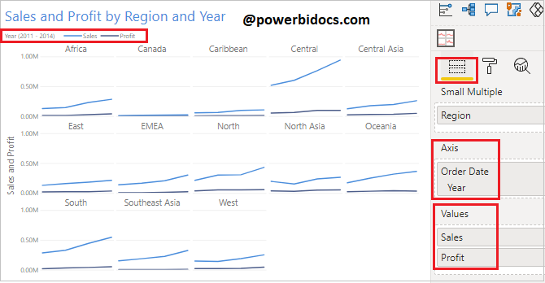
Small Multiple Line Chart Visual in Power BI

Slide 62
Small Multiple Line Chart Visual in Power BI
Format the Small multiple line chart
Now set the small multiple line chart format like, font size, font family, X & Y axis, SM layout, SM styling & Line styling.
Now select the visual and go to format bar & follow these properties-
General: Allows you to set X axis, Y axis, width & height for SM visual.
SM Layout:
Set the Column Sizing, you can display the number of columns per row as per your choice.
Column Spacing: Provide the space between columns.
Row Sizing: You can fixed the row heights & also give the space between each rows.

Slide 63
Small Multiple Line Chart Visual in Power BI
SM Heading: Turn on SM heading & set font color, position, alignment, text size & font family. Here SM heading is Region text.
SM Styling: Allows you to set the background and alternate background color for small multiple line chart. Also you can set the border & border style for chart.
Line Styling: Here you can set the line color for Sales & profit, also you can enable the show area, change the Shape & line style
X-Axis: Allows you to set the Title, Font color, Font size, Text size, show label, Gridline, Axis domain line & color.
Y-Axis: Allows you to set the Title, Font color, Font size, Text size, show label, Display unit & Gridlines.
Legend: Set legend Title, Font color, Text size & Position for legend.

Slide 64
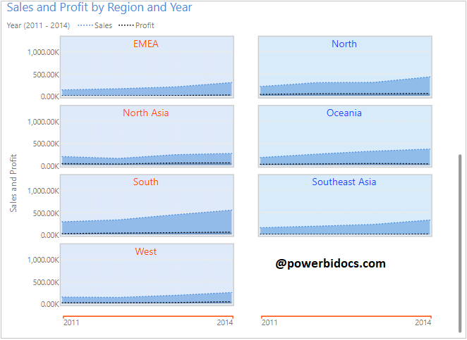
Small Multiple Line Chart Visual in Power BI

Slide 66
Power BI DAX Functions
Data Analysis Expressions (DAX) is a library of functions and operators that can be combined to build formulas and expressions in Power BI, Analysis Services, and Power Pivot in Excel data models.
Power BI support more then 200 types of DAX functions like- Date & Time functions, Filter functions, Text functions, Information functions, Logical functions, Time intelligence functions, Mathematical functions etc.

Slide 67
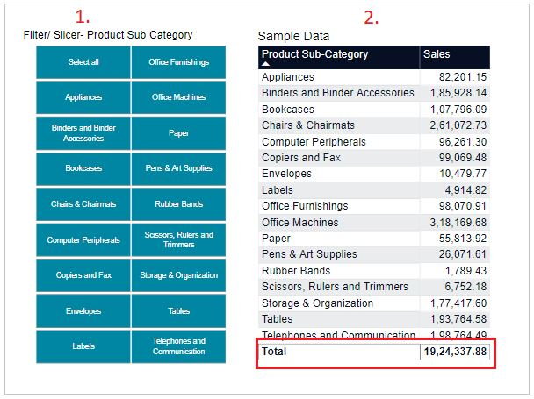
DAX Functions
Let’s start with an example, you can download the sample Dataset SuperStoreUS-2015.xlxs

Slide 68
DAX Functions - ALL
So now, we will create Measure to using DAX ALL function and in that measure we will do sum of ‘Sales’ column.
ALL_DAX = CALCULATE(Sum(Orders[Sales]), ALL(Orders[Product Sub-Category]))
We passed ‘Product sub category’ column under ALL function, so in that case whatever filters you apply, it will always returns sum of all ‘Product Sub Category‘ and that is 19,24,337.88 .

Slide 69
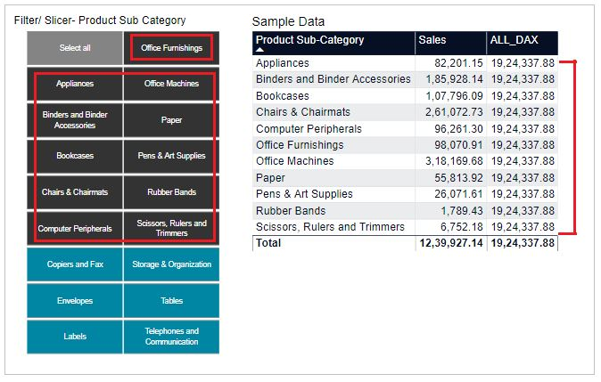
DAX Functions

Slide 70
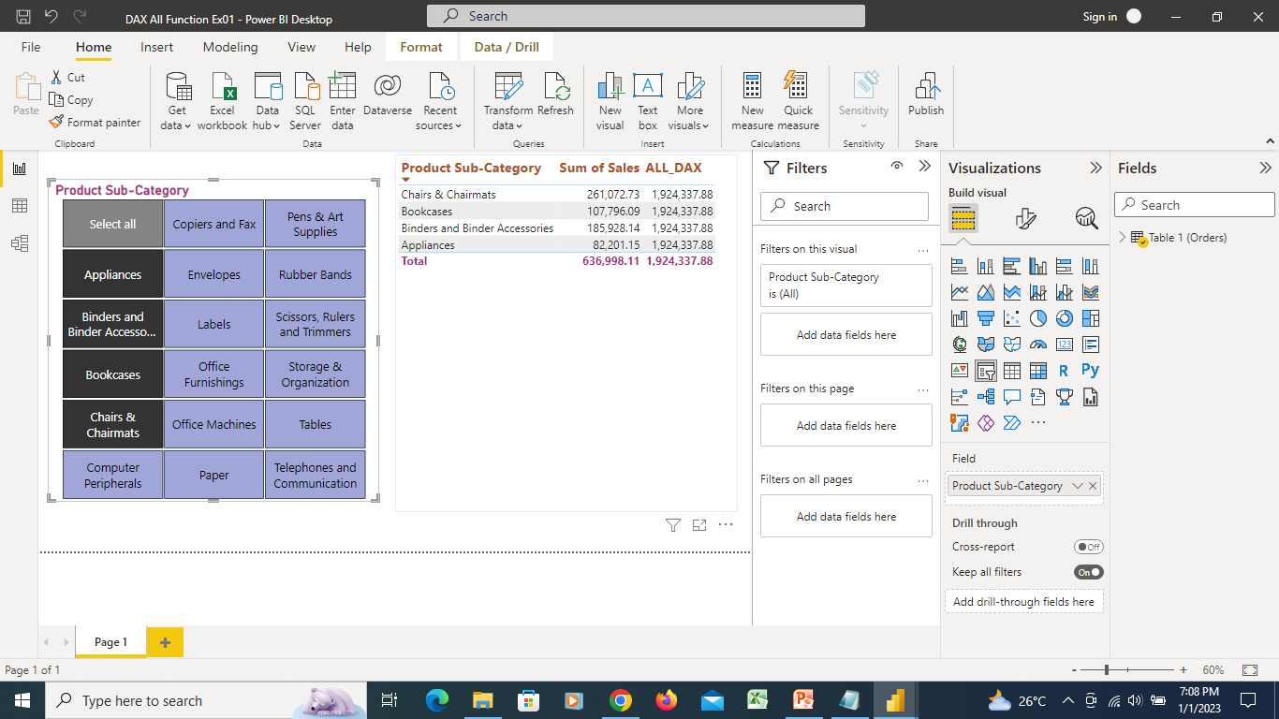
DAX Function - ALL

Slide 71
ALLSELECTED
ALLSELECTED function
Returns all the rows in a table, or all the values in a column
Removes context filters from columns and rows in the current query
keeping filters that come from outside.

Slide 72
ALLSELECTED
Use the same Dataset
SuperStoreUS-2015.xlxs
Now, create a Measure to use DAX ALLSELECTED function and in that measure do sum of ‘Sales’ column.
ALLSELECTED_DAX = CALCULATE(Sum(Orders[Sales]),ALLSELECTED(Orders[Product Sub-Category]))

Slide 73
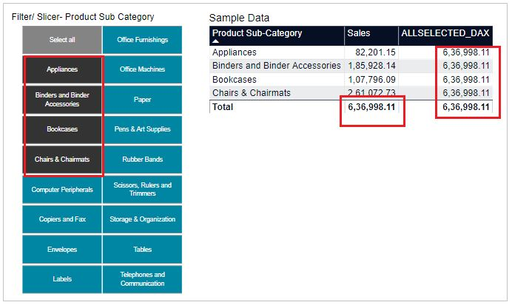
ALLSELECTED

Slide 74
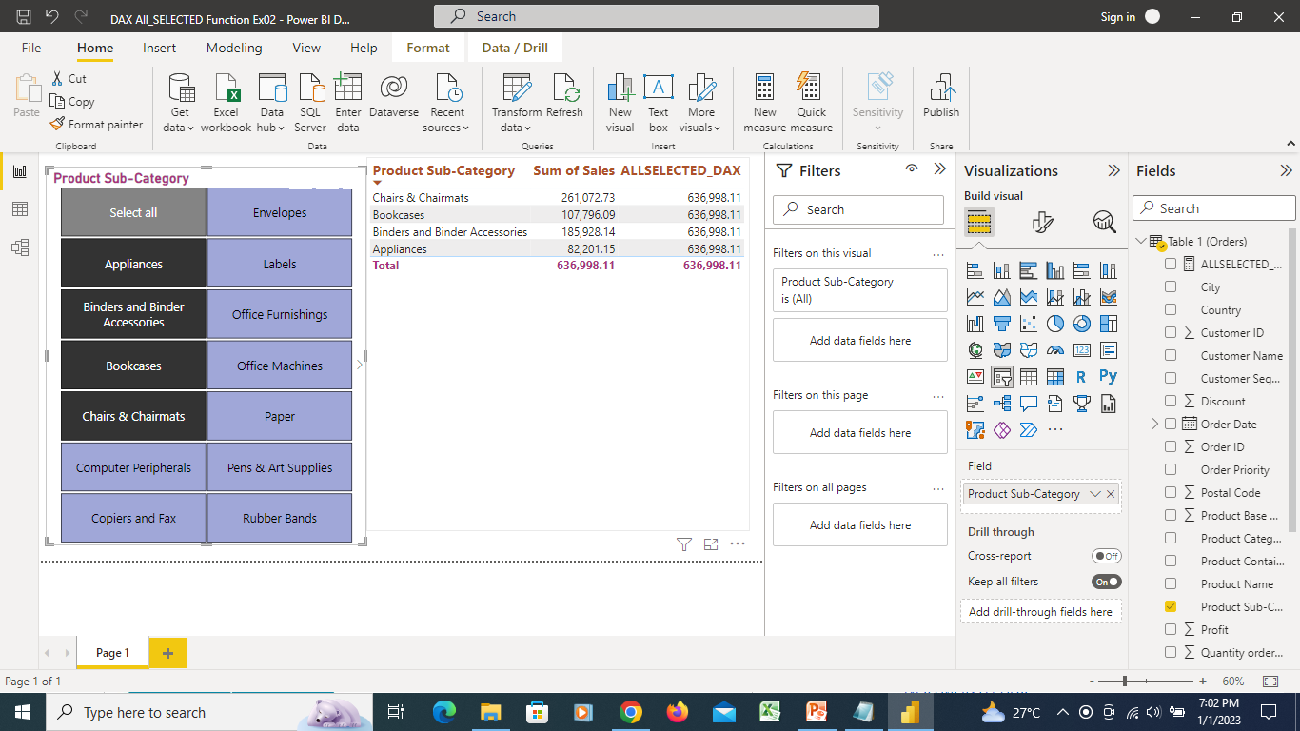
DAX Function - ALLSELECTED

Slide 75
DAX – ALLEXCEPT function
Is a DAX function and it removes all context filters in the table except filters that have been applied to the specified columns. Its comes under Filter functions Dax category.
Step 1: Download Sample data : SuperStoreUS-2015.xlxs
Step 2: Drag Table & Slicers from visualization Pane.
Slicers: Drag Product Category in first slicer & Product sub category in second slicer
Table: Drag three fields in table, Product Category, Product Sub Category & Sales from Orders Dataset

Slide 76
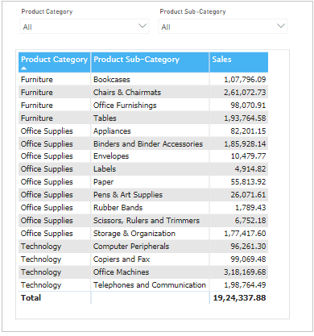
DAX – ALLEXCEPT function
Step 3: Create Measure and write DAX formula for ALLEXCEPT function.
ALLEXCEPT_SALES =
CALCULATE (
SUM ( Orders[Sales] ),
ALLEXCEPT ( Orders, Orders[Product Category] )
)
Step 4: Now Drag ALLEXCEPT_SALES measures into table.

Slide 77
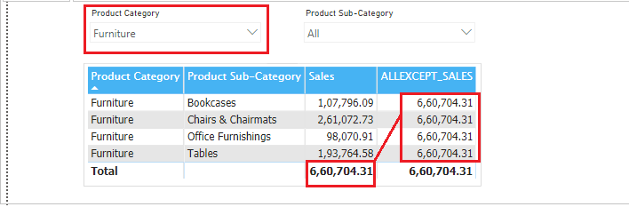
DAX – ALLEXCEPT function
Step 5: Now put filter on Product Category & see the measure ALLEXCEPT_SALES result, it is returning Total Sales sum of Furniture.

Slide 78
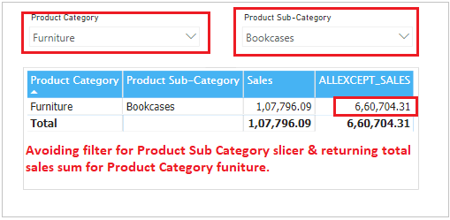
DAX – ALLEXCEPT function
Step 6: Now put filters on both slicers and see the result.

Slide 79
DAX – Calculate Function
CALCULATE is the most often used DAX function in Power BI, this function works as a base function to apply other DAX functions in different scenarios.
It evaluates the expression given by the user with all the applied filters.
Use SuperStoreUS-2015.xlxs
SUMX with filter =
SUMX(Filter(Orders, Orders[Product Category]="Furniture"),
Orders[Sales])

Slide 80
DAX – Calculate Function
SUM Measure = CALCULATE(
SUM(Orders[Sales]),----Expression
Filter(Orders, Orders[Product Category]="Furniture"))– filter
COUNTROWS = CALCULATE(
COUNTROWS(Orders),
FILTER(Orders, Orders[Region]="East"))
Distinct Count = CALCULATE(
DISTINCTCOUNT( Orders[Product Category]),
Filter(Orders, Orders[Region]="EAST" ))

Slide 81
DAX – Calculate Function
Calculate with Multiple filter =
CALCULATE(
SUM(Orders[Sales]),----Expression
Filter(Orders, Orders[Product Category]="Furniture"),-- Filter1
Filter(Orders, Orders[Region]="West"))-- Filter 2

Slide 82
DAX – CALCULATETABLE Function
CALCULATETABLE DAX function comes under Power BI Filter DAX category and It evaluates a table expression in a context modified by the given filters. It returns a table of values.
CALCULATETABLE allows you to create virtual tables that you can filter using multiple conditions and use that table to make further calculations.
CALCULATETABLE(<expression> , <filter1> , <filter2> , …)
Sample Dataset- Global_superstore_2016.xls

Slide 83
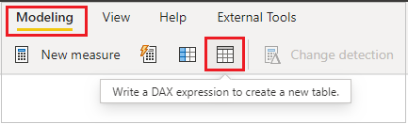
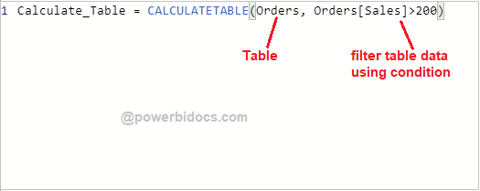
DAX – CALCULATETABLE Function
Step-1: Go to Modeling Tab > Select “DAX expression to create a new table”.
Step-2: After that Write below DAX function

Slide 84

DAX – CALCULATETABLE Function
Step-3: As you can see in below screenshot, it return new table with given condition data where sales is > 200.

Slide 85

CALCULATETABLE with Measure-
You can also use CALCULATETABLE with measure based on your requirement.
It will create virtual tables that you can filter using multiple conditions and use that table to make further calculations.
Step-1: Create one measure and write below DAX code.
Calculate_Table_with_measure =
SUMX(
CALCULATETABLE(Orders, Orders[Sales]>200),
Orders[Sales])

Slide 86

CALCULATETABLE with Measure-
Step-2: Add one card visual and drag measure.
Verify the Table output

Slide 87
CALCULATETABLE function with SUMMARIZE function
As you have seen above, a CALCULATETABLE function returns a table based on given filter condition, and it return all columns of base table.
But if you want to see only specific columns then you can use SUMMARIZE DAX function with CALCULATETABLE.
Now go to modeling tab > Add new DAX table
Calculatetable_with_Summarize =
CALCULATETABLE(
SUMMARIZE(Orders, Orders[Category], Orders[Sub-Category], Orders[Sales]),
Orders[Sales]>500)
Check output in Data

Slide 89
Dashboard
A Power BI dashboard is a single page, often called a canvas, that tells a story through visualizations.
Because it's limited to one page, a well-designed dashboard contains only the highlights of that story.
Readers can view related reports for the details.
Dashboards are a feature of the Power BI service.

Slide 90
Dashboard
What is a dashboard used for?
Dashboard definition A dashboard is a way of displaying various types of visual data in one place.
Usually, a dashboard is intended to convey different, but related information in an easy-to-digest form.

Slide 91
Dashboard
Simply put, a data dashboard can be defined as an information management tool that visually tracks, analyzes, and displays key performance indicators (KPI), metrics, as well as key data points, allowing you to monitor the current state of your business, department, team, or specific process

Slide 92
What are benefits of dashboards
Most specifically, the right dashboard will give you six key benefits as follows:
Total Visibility into Your Business. ...
Big Time Savings. ...
Improved Results. ...
Reduced Stress. ...
Increased Productivity. ...
Increased Profits: As discussed, your dashboard shows you exactly which areas of your business are performing poorly.

Slide 93
Dashboard vs Reports
Capability | Dashboards | Reports
Pages | One page | One or more pages
Ask a question about your data (Power BI Q&A) field at top | almost always | no
Data sources | One or more reports and one or more datasets per dashboard | A single dataset per report
Filtering | Can't filter or slice | Many different ways to filter, highlight, and slice
Set alerts | Can create alerts to email you when certain conditions are met | No
Featured | Can set one dashboard as your "featured" dashboard | Cannot create a featured report
Can see underlying dataset tables and fields | No. Can export data but can't see tables and fields in the dashboard itself. | Yes. Can see dataset tables and fields and values.

Slide 94
Dashboard
Create Dashboard..
Open Power BI Services
Open a Report which u have prepared earlier.
Select the visual you like and select the pin Icon to pin dialog box to pin in dashboard
So the select visual is a tile in dashboard
Proceed and select other visual from same or other reports
Selected visuals are pin in dashboard as TILES.

